Slide 1




SMART INDIA HACKATHON 2026
TITLE PAGE
  Problem Statement ID - SIH26136
  Problem Statement Title - Startup friendly public procurement mechanism that enables government departments to identify,pilot, procure, and scale innovative solutions from eligible startups
  Theme - Miscellaneous
  PS Category- Software
  Team ID-
  Team Name - LazyCoder’s 2.0

Slide 2





















IDEA TITLE
PROPOSED SOLUTION
Define Challenge
Government creates a sstructured problem statement.
An AI-assisted Innovation-to-Procurement Platform that connects government departments with verified startups and takes successful innovations from problem identification to pilot, procurement and scale.
AI Structure
OUR SOLUTION — GOVINNOVATE
AI analyzes the challenge and creates a structured opportunity
Discover & Match
SOLUTION WORKFLOW
Government creates a sstructured problem statement.
  Define: Government creates a structured challenge
  AI Structure: AI analyzes the challenges and create a structured opportunity
  Discover and Match: AI/NLP finds relevant eligible startups
  Verify: DPIIT, company & evidence verification
  Evaluate: Independent expert technical assessment
  Pilot: Controlled pilot with milestones & KPIs
  Validate: Evidence + expert validation + user feedback
  Procure: Government reviews and selects applicable procurement pathway
  Scale: Successful solutions expand across departments/locations
Evaluate
Independent experts assess solutions on predefined criteria.
PILOT
Selected solutions are implemented in a controlled pilot.
Feedback
  AI Problem-to-Startup Matching – Semantic matching based on problem, technology, sector and capability.
  Evidence-First Verification – Structured verification of startup credentials, claims and supporting evidence.
  Expert-in-the-Loop Evaluation – AI assists evaluation; domain experts validate technical evidence.
  Pilot-to-Procurement Bridge – Connects validated pilot outcomes with the appropriate procurement pathway.
  Milestone-Based Governance – Tracks KPIs, evidence, approvals and payment milestones throughout the pilot.
  RAG Policy Assistant – Provides policy/procurement guidance grounded in approved documents
  Audit Logs- Audit of every actions performed by Government and Experts are maintained for transparency.
Collect feedback from Department , citizens and pilot stakeholders
KEY INNOVATIONS
Validate
Assess pilot results with measurable outcomes
Procure
Goverenment reviews and selects applicable procurement pathway
Scale
Expand successful solutions across departments and locations
@SIH Idea submission- Template
2

Slide 3






























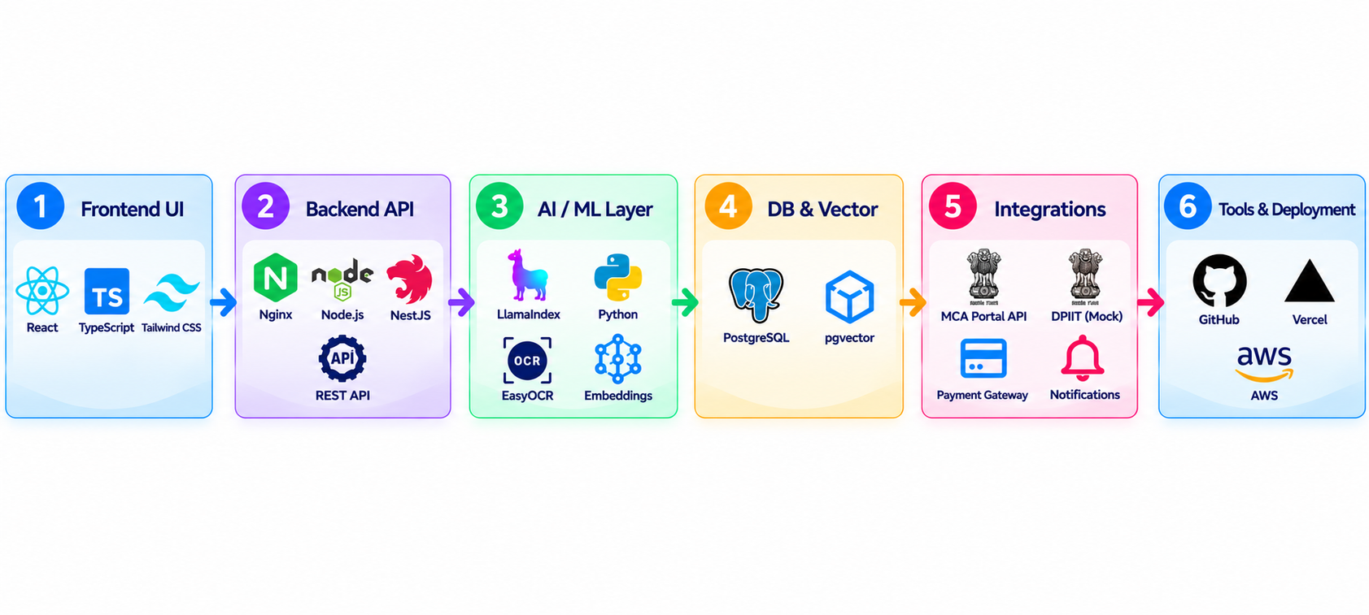




TECHNICAL APPROACH
Document
Processing &
Verification
AI/ML Model
Sorting
Expert Evaluation
Pilot
Monitoring
StartUp
Registration
Milestone based payment
Government
Problem
StartUp
Submits Solution
Rewards
Disbursement
Verification Layer
StartUp01
KPI Evaluation
Store in Database
MileStones
DPIIT
Verificaton
CIN
Verification
PostgreSQL
+
pgVector
StartUp02
Expert Report
Mock Data
API
MCA
API
StartUp03
Scaling
Verified !
FeedBack
5
Security
JWT
Payment Gateway
Technology Stack
Notification
@SIH Idea submission- Template
3

Slide 4











FEASIBILITY AND VIABILITY
FEASIBILITY
FEASIBILITY
VIABILITY
Can we build and implementn it
Can we build and implement it?
Can it be adopted, operated and scaled?
Technically Feasible
High Adoption Potential
Open-source and proven technologies: React/Typescript, Node.js, PostgreSQL + pgvector, LlamaIndex and Gemini APIs.
Solves real government problems and gives startups a clear path from pilot to procurement.
Operationally Feasible
Cost-Effective
Clear roles for Government, Startups, Experts, Admin and Citizens with defined workflows.
Uses existing infrastructure and open-source tools to reduce development and operational costs.
Data Feasible
Scalable Model
Public documents, government challenge data and startup submissions can be securely stored with audit logs.
Modular, cloud-ready and replicable across departments and states.
Implementation Feasible
Long-Term Value
Modular, API-first and prototype-ready design enables phased development.
Improves public service delivery and creates measurable social and economic impact.
We have what it takes.
The building blocks exist.
Not just possible.
Built for long-term impact
BUILD
PILOT
SCALE
IMPACT
PILOT
@SIH Idea submission- Template
4

Slide 5

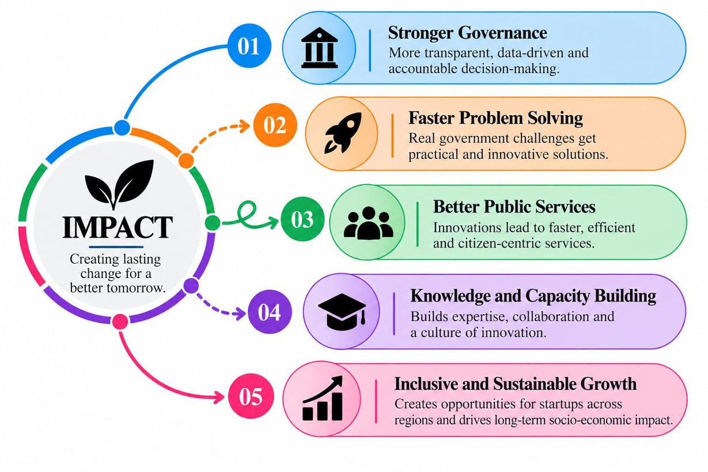
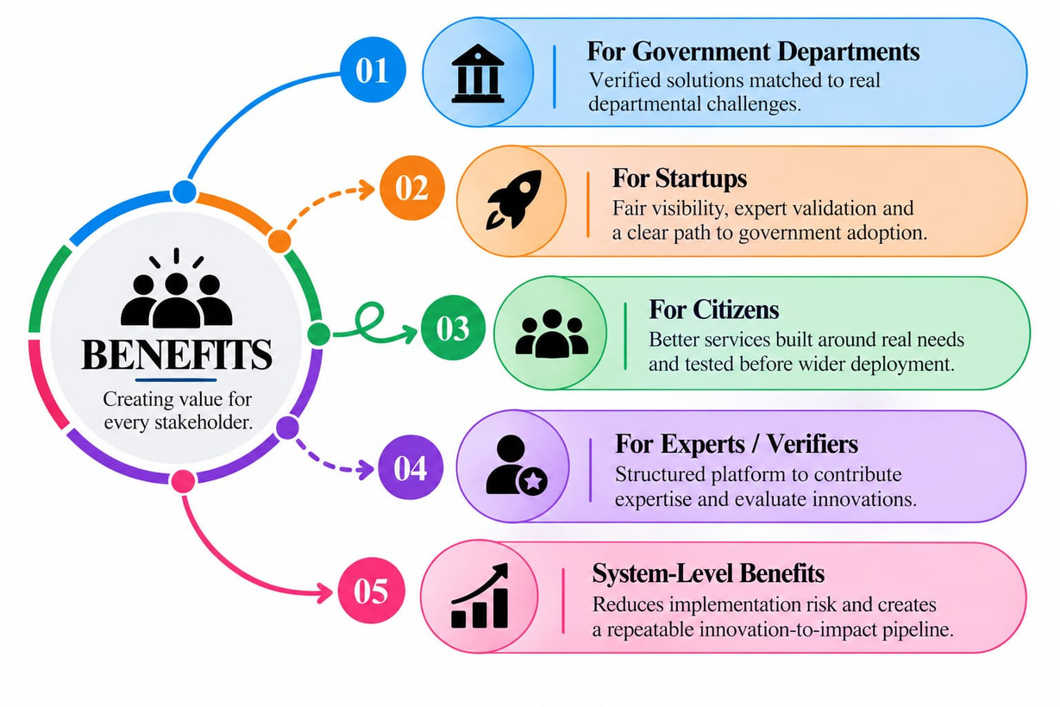
IMPACT AND BENEFITS
( FROM GOVERNMENT CHALLENGES TO REAL - WORLD SOLUTIONS )
@SIH Idea submission- Template
5

Slide 6



RESEARCH AND REFERENCES
RESEARCH PAPER
  Strengthening Startup Engagement in Public Procurement: An Incubator-Led Approach to GeM Enablement in India- https://papers.ssrn.com/sol3/papers.cfm?abstract_id=6530078
  On Recent Advances in Public Procurement: An Exploration of the Government e-Marketplace in India--https://onlinelibrary.wiley.com/doi/abs/10.1002/pad.2113
REFERENCES
  Maharashtra State Innovation Society (MSInS) —https://msins.in/
  Manual for Procurement of Goods – 2024 — https://doe.gov.in/manuals
  General Financial Rules (GFR), 2017 — https://doe.gov.in/bi-annual-compilationupdation-general-financial-rules-2017-upto-31012026general-financial-rules
  Startup India – Public Procurement — https://www.startupindia.gov.in/content/sih/en/public_procurement.html
  GeM— https://gem.gov.in/
GitHub Repo
Report
Prototype
@SIH Idea submission- Template
6

